Slide 1
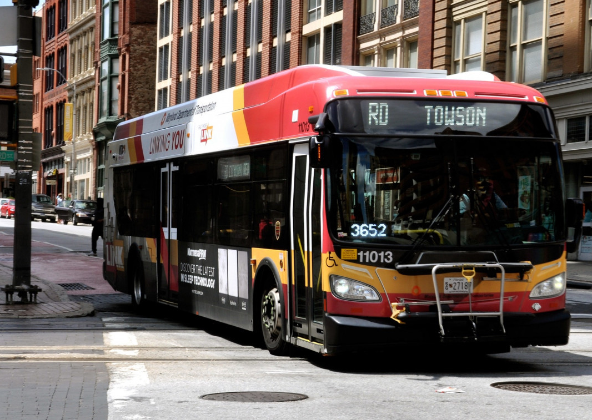
Is Public Transportation in the US Struggling?
Guruprasad Velikadu Krishnamoorthy

Slide 2
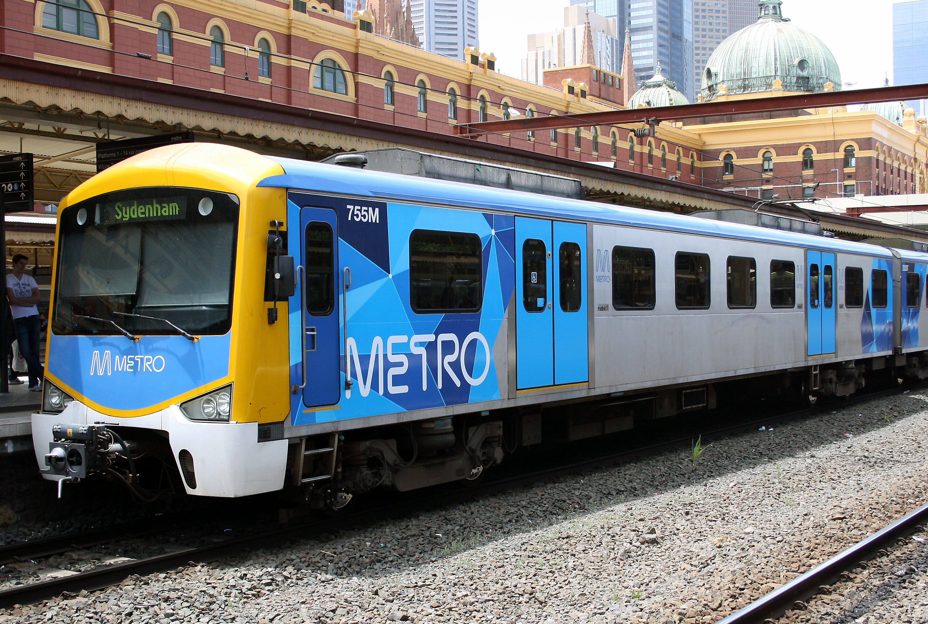
Agenda
How people commute to Work every day ?
How many people use Public Transit vs Cars?
Who uses Public Transport?
How the Public Transit performed Post-Pandemic?
Why Investing in Public Transit is necessary?
Federal Funding for Public Transit vs. highway spending
More Opportunities to Explore

Slide 3
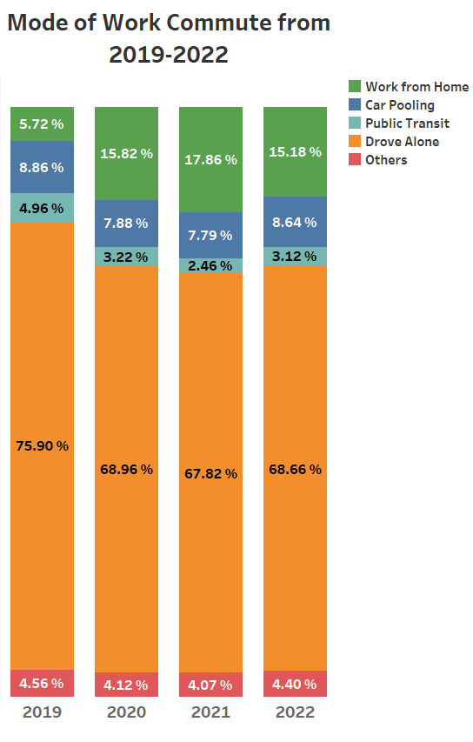
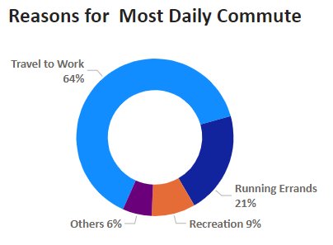
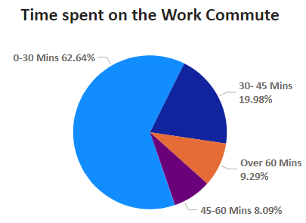
Why do People Commute, and How do they Commute?
Most people’s daily commute was work-related.
About 63% of the work commute lasted less than 30 minutes.
The share of people working from home had increased post-pandemic, though the share of people using Public Transport for work commutes had remained low over the years.
Many people prefer carpooling to public transit for work commute.
The share of people using Public Transportation has been meager over the years

Slide 4
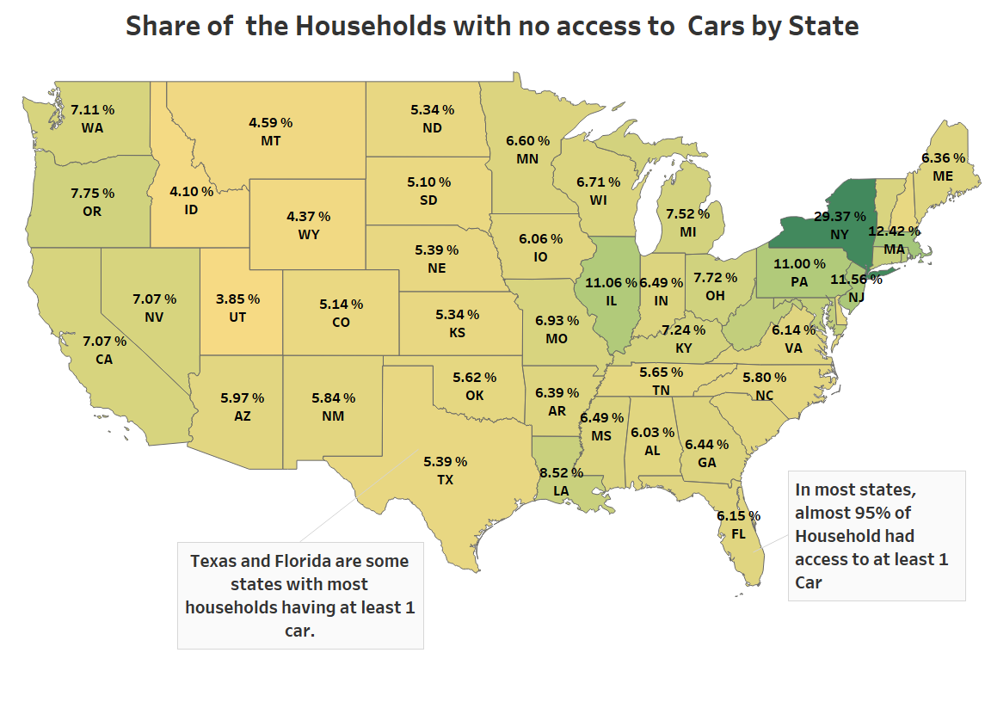
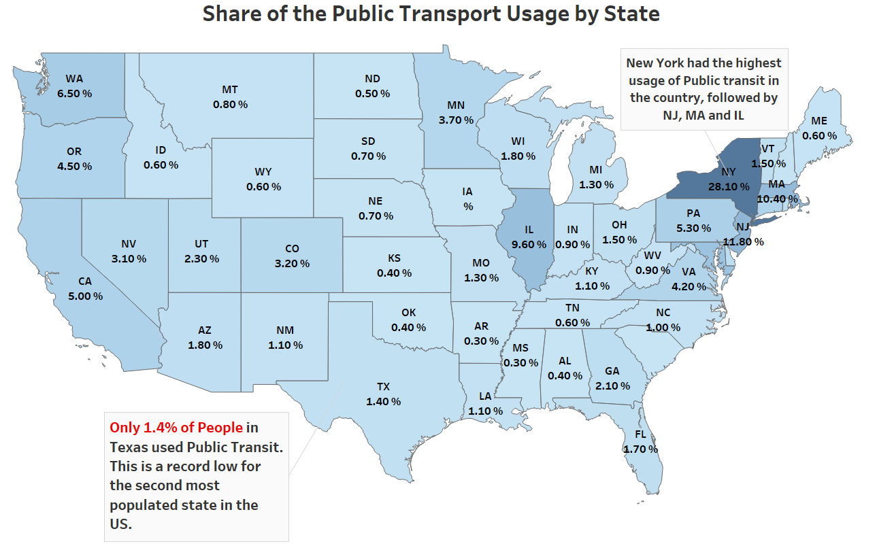
How many people use Public Transit in the US?
Public Transit usage was shallow in most states except New York, Illinois, and Massachusetts. 95% of the households in states such as Texas and Florida had more than one car, primarily due to the non-availability of reliable Public Transit.

Slide 5
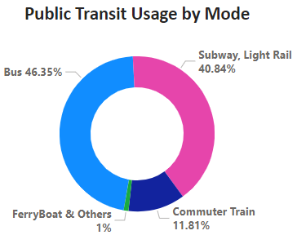
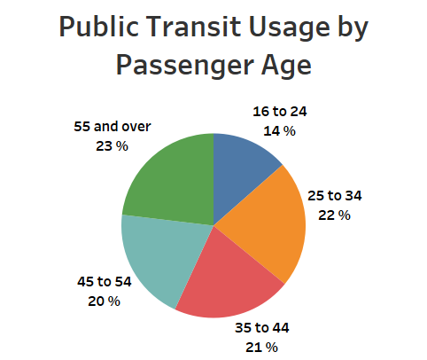
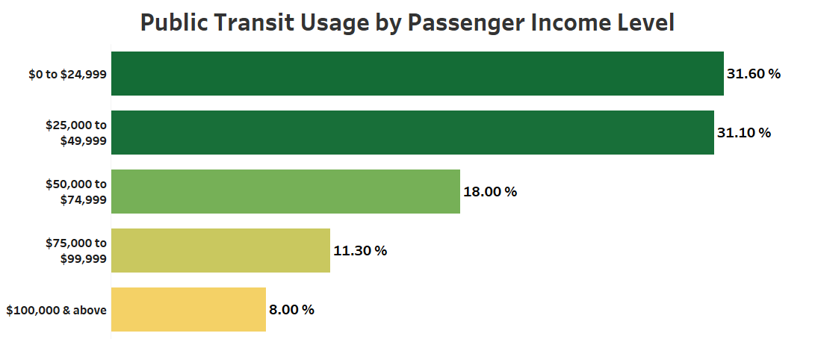
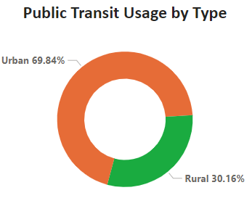
Who uses the Public Transit?
Over 85% of Public transit trips were made by Bus, Subway, or Light Rail. Most of the trips were in the Urban areas.
Most people who used Public Transit earned less than 50K annually as of 2019.
Public Transit usage was similar across all age groups, with 55 and older using the Most.

Slide 6
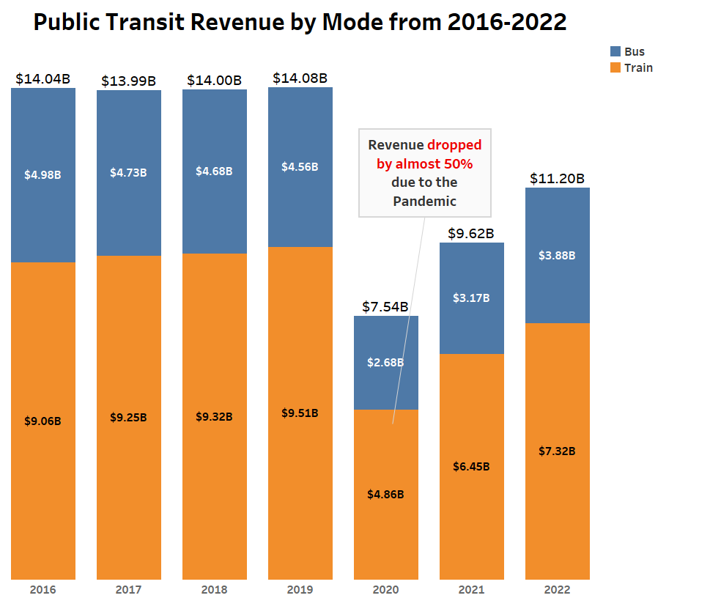
Impacts to Revenue due to the Pandemic
The bus revenue dropped slightly from 2016 to 2019, while train revenue increased.
In 2020, due to COVID-19, both revenues dropped by 50% and are recovering post-pandemic.
The train revenue has exceeded the bus revenue over the years.

Slide 7
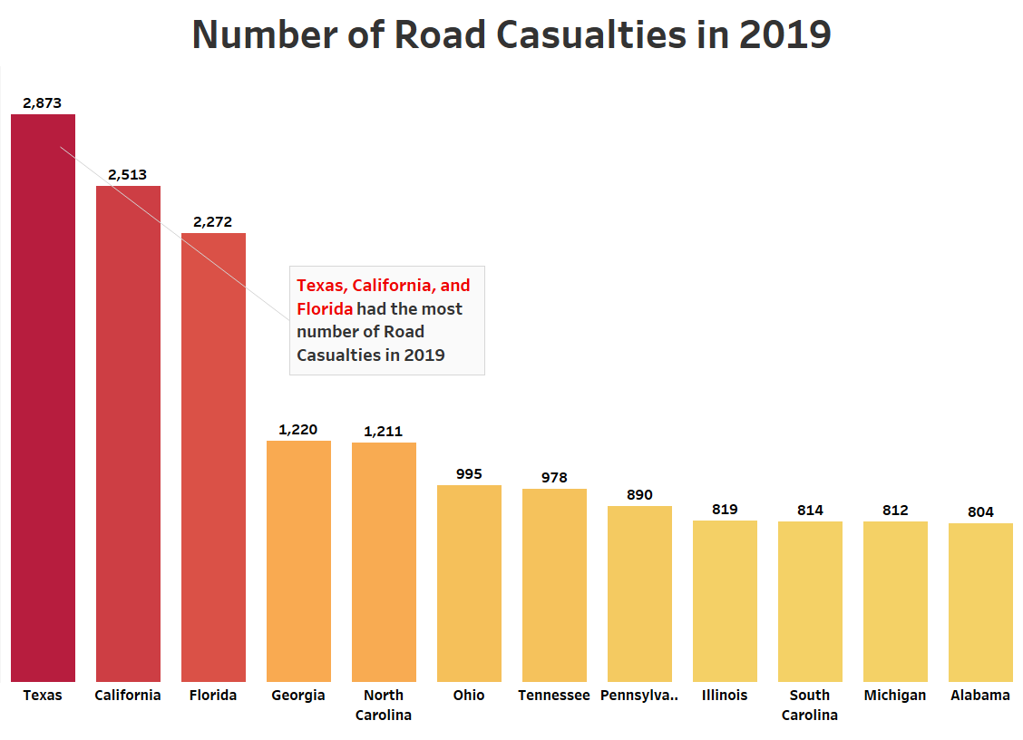
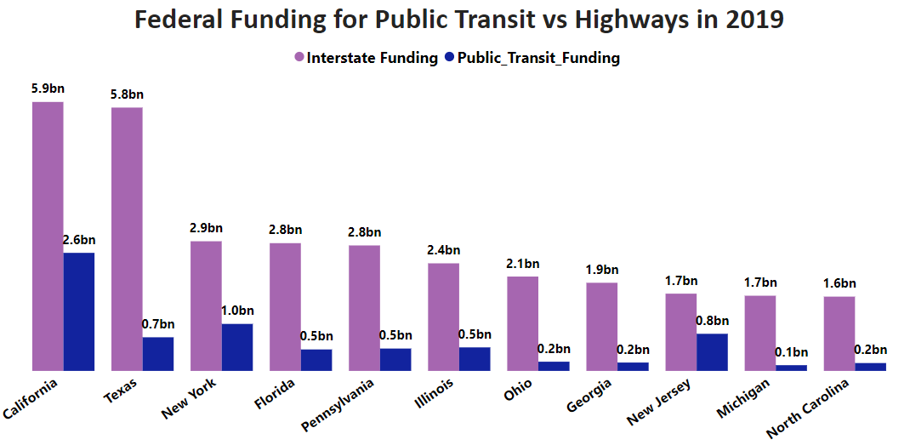
Federal Funding
Texas received 8 times more Federal funding for building Highways than Public Transit
In many states, the Federal funding for Highways was almost 5 times higher than the Public Transit Funding. Texas, which had the country's greatest number of road causalities, received 8 times more funding for Highways than the Public transit budget. Hence, It is an utmost priority to increase the federal funding for Public transit.

Slide 8
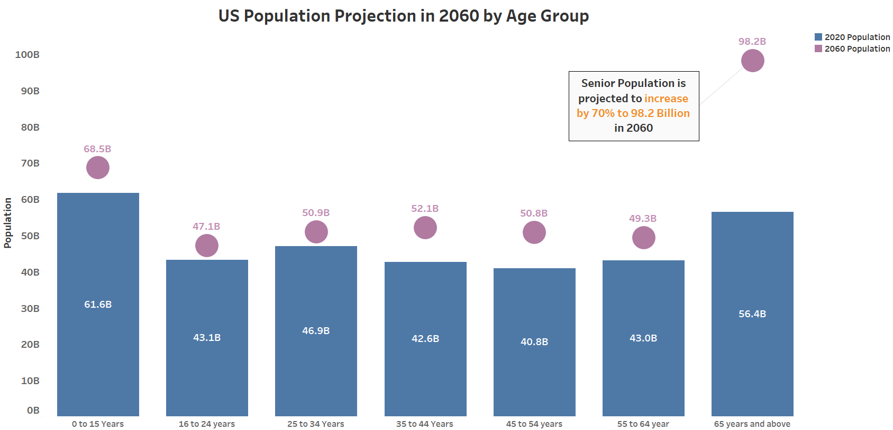
Why Investment in Public Transit is necessary?
The US Population is expected to increase by 15% to 415 Million by 2060, thus making it a priority to invest more in Public transit, especially in the already congested Metros.
The Senior population (65 Years and above) is expected to increase by 70% to almost 100 Billion by 2060. Most seniors prefer to use public transit thus making it a priority to invest more in it.

Slide 9
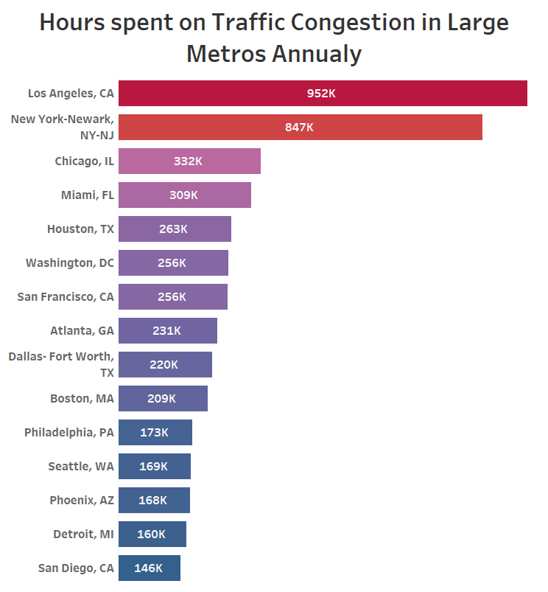
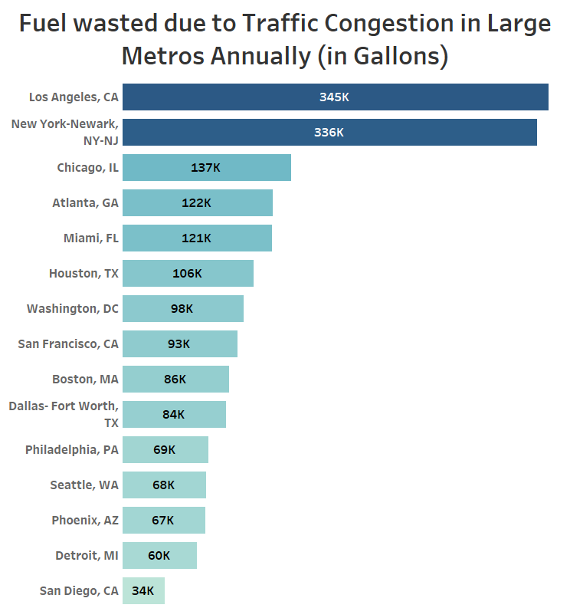
Why Investment in Public Transit is necessary? (continued)
Drivers in Los Angeles, New York City, and other Big metros spent thousands of extra hours on the road and burnt thousands of extra Gallons of gas due to Traffic Congestion.
Using Public Transit is the solution to this problem, especially in the Big Metros, also reducing environmental pollution.
It can also add an estimated 200k additional jobs across the country.

Slide 10
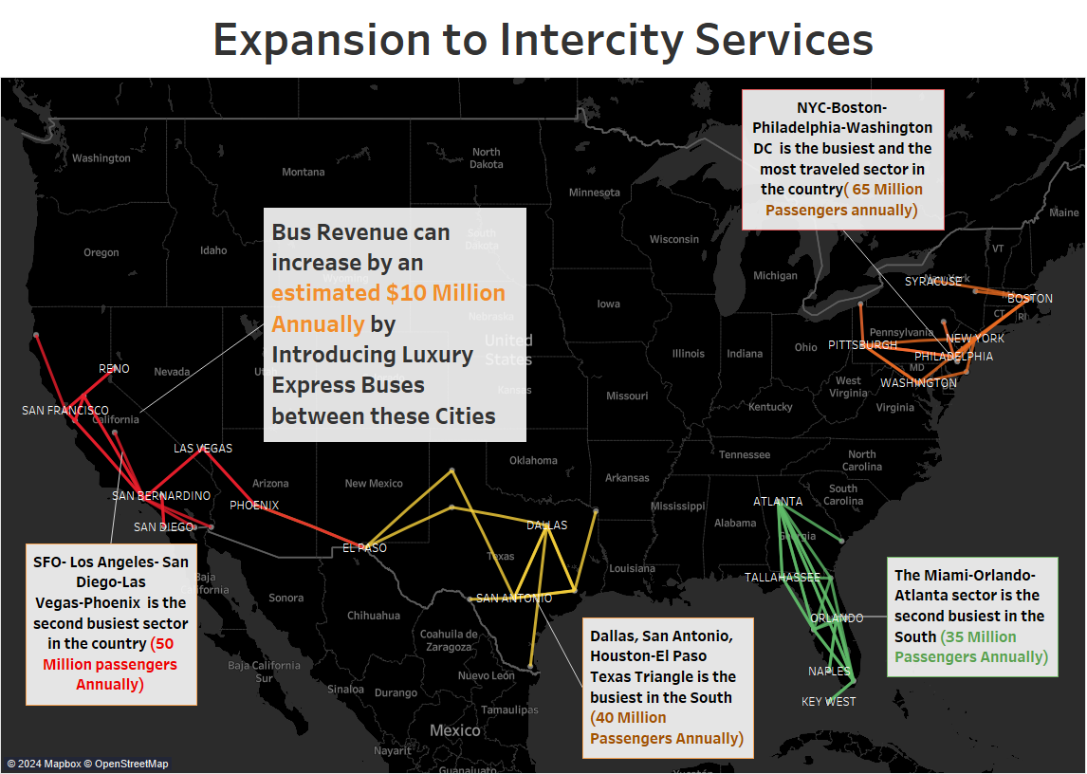
More Opportunities to Explore
Some of the most popular inter-city routes are shown on the map. Millions of people take these routes each year.
By introducing luxury and express bus coaches on these routes or partnering with services like Greyhound, revenue can see a boost of $10 Million annually.
As a pilot, express bus services can be introduced between Dallas, San Antonio, and Houston.
Also, opportunities to utilize the existing Freight rail routes to introduce express trains for Passenger traffic can be explored.

Slide 11
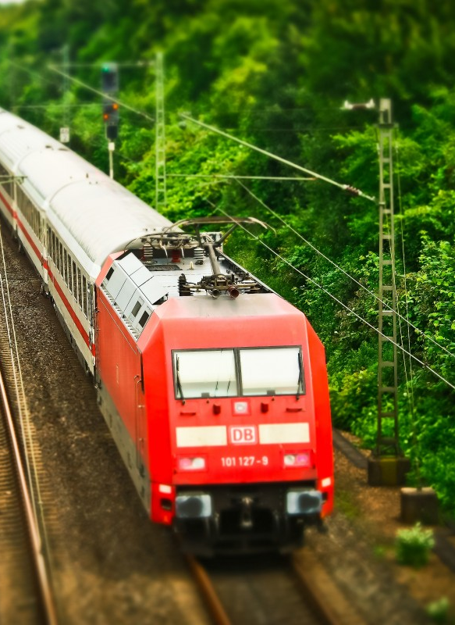
Key Takeaways
Most people prefer to drive alone to work, and some choose carpooling. The Public Transit usage was shallow in most states.
Public transportation is mainly used by people who make less than 50k. Seniors aged 65 and above, are the biggest users of Public transit.
The US Public transportation ridership and revenue dropped significantly due to the pandemic and is recovering. It is not dying as what the media is projecting.
Federal funding for Public transit has been historically low compared to highway funding. The gap is so vast that there is little investment in Public transit in states like Texas.
Strengthening the existing public transportation system is a top priority due to the future changing demographics and reducing traffic congestion in ever-growing metros. This can also provide more job opportunities in the future.
The current city transit systems can be expanded further to Intercity express services by adding more buses or through partnerships, thus boosting the revenue.

Slide 12

Thank you

